Slide 1
Computer Modeling and Simulation
Lectures 12 & 13

Slide 2
Monte Carlo Simulation
Monte Carlo is the gambling locale in the country of Monaco. It is the home of the famous Le Grand Casino as well as many other gambling resorts.
Monte Carlo simulation is about a concept that underlies gambling, that is, probability, hence, its association and designation with the well - known gambling region.
Gambling casinos rely on probability to ensure, over the long run, that they are profitable.
  For this to happen, the odds or chance of the casino winning has to be in its favor.
  This is where probability comes into play because the theory of probability provides a mathematical way to set the rules for each one of its games to make sure the odds are in its favor .
As a simulation technique, Monte Carlo simulation relies very heavily on probability

Slide 3
Monte Carlo Simulation – Coin Tossing example
Consider you have a coin which you toss four times and you want to find the probability of having 3 heads and 1 tail.
Using combinatorics, we’ll find the probability in the following way
P(3 heads) =

Slide 4
Monte Carlo Simulation – Coin Tossing example
Simulation is repeatedly performing an experiment.
In the example, being discussed, one experiment will consist of four coin tosses and then you repeatedly perform this experiment to see how many times of the total experiments, you get three heads and one tail.
The more the number of experiments is, the closer will be this probability, determined by repeated experiments (simulation), to the actual probability (determined using combinatorics).

Slide 5
Monte Carlo Simulation – Python program for Coin tossing example
from random import randint
successes = 0
attempts = 10000
for i in range(attempts):
if randint(0,1)+randint(0,1)+randint(0,1)+randint(0,1) == 3:
successes += 1
print(“No. Of attempts is”, = attempts)
print(“No. Of successes is”., = successes)

Slide 6
Monte Carlo Simulation – More difficult problems
Consider the game of war.
Description of war game. https://www.youtube.com/watch?v=yX-jOVer758
How long will the game go i.e. on average, how many rounds will a game of war contain?
The solution to this problem using combinatorics will be very difficult as we have to consider all the combinations of a cards in each deck as the entire game depends on that combination.
Using monte carlo

Slide 7
History of Monte Carlo Simulation
The Monte Carlo simulation was invented in the way we just saw in the example of cards.
The technique was first developed by Stanislaw Ulam, a mathematician who worked on the Manhattan Project.
After the war, while recovering from brain surgery, Ulam entertained himself by playing countless games of solitaire.
He became interested in plotting the outcome of each of these games in order to observe their distribution and determine the probability of winning.
After he shared his idea with John Von Neumann (the brain behind the stored program computer), the two collaborated to develop the Monte Carlo simulation.
While developing the nuclear weapons, scientists knew the behavior of one neutron, but they did not have a formula for how a system of neutrons would behave.
Although they needed to understand such behavior to construct dampers and shields for the atomic bomb, experimentation was too time consuming and dangerous.
John von Neumann and Stanislaus Ulam developed the technique of Monte Carlo simulation to solve the problem.

Slide 8
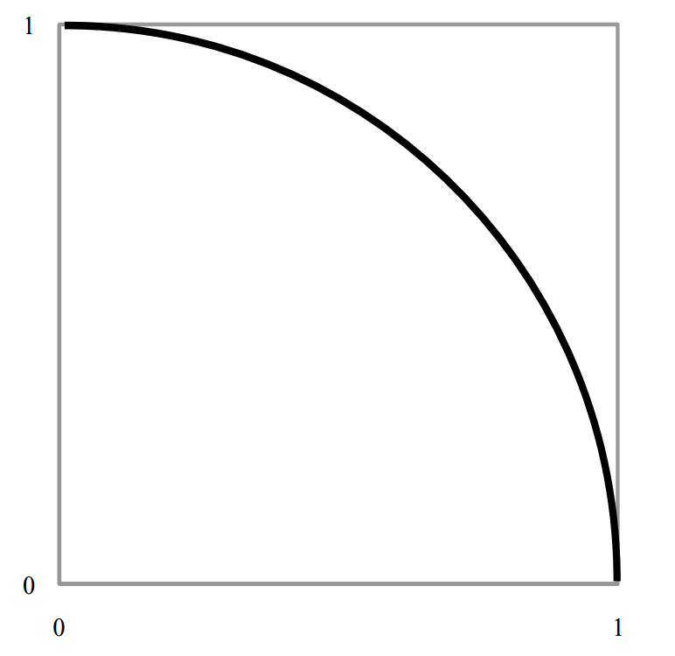
￼
Calculating value of pi using Monte Carlo simulation
Recall that the value of π is the ratio of a circle ’ s circumference to its diameter.
To calculate this value, we can set up a Monte Carlo simulation that employs a geometric representation of the circle.
Step 1: To start, draw a unit circle arc, that is, an arc of radius one circumscribed by a square as shown in the figure.

Slide 9
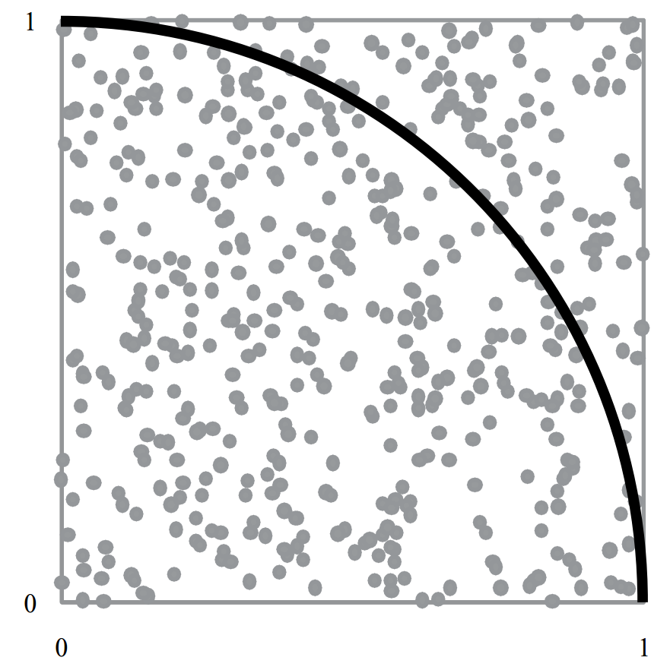
Calculating value of pi using Monte Carlo simulation
Step 2: Then, randomly choose an x and y coordinate inside the square, and place a dot at that location.

Slide 10
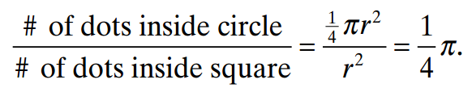
Calculating value of pi using Monte Carlo simulation
Step 3: Repeat step 2 at a given number of times.
Step 4: Count the total number of dots inside the square and the number of dots inside the quarter circle.
Step 5: With a large number of dots generated, these values will approximate the area of the circle and the area of the square.
From mathematics, this result can be represented as

Slide 11
Definition of Monte Carlo Simulation
Monte Carlo Simulation is this concept of repeated random samples of model input variables over many simulation runs .
When setting up a Monte Carlo simulation or employing the Monte Carlo Method, one follows a four - step process.
Step 1 Define a distribution of possible inputs for each input random variable.
Step 2 Generate inputs randomly from those distributions.
Step 3 Perform a deterministic computation using that set of inputs.
Step 4 Aggregate the results of the individual computations into the final result.

Slide 12
Step 1:
  Step 1 Define a distribution of possible inputs for each input random variable.
  Random variable is a variable whose values depend on outcomes of a random phenomenon.
  For example: The outcome of a coin toss is a random variable with possible values of Head or Tail.
  The distribution of these random numbers is a description of the portion of times each possible outcome or each possible range of outcomes occurs on the average over a great many trials.
  Different distributions:
    Uniform distribution Suppose a specified range is partitioned into intervals of the same length. With a uniform distribution, the generator is just as likely to return a value in any of the intervals.
    Normal distribution
    Exponential Distribution
    Triangular Distribution etc.

Slide 13
Pseudorandom Numbers
Pseudorandom numbers are generated by computers.
They are not truly random, because when a computer is functioning correctly, nothing it does is random.
Computers

Slide 14
Applications of Pseudorandom Numbers
Pseudorandom numbers are essential to many computer applications, such as games and security. In games, random numbers provide unpredictable elements the player can respond to, such as dodging a random bullet or drawing a card from the top of a deck.
In computer security, pseudorandomness is important in encryption algorithms, which create codes that must not be predicted or guessed.

Slide 15
Pseudorandom number generator
A pseudorandom number generator, or PRNG, is any program, or function, which uses math to simulate randomness. It may also be called a DRNG (digital random number generator) or DRBG (deterministic random bit generator).
The math can sometimes be complex, but in general, using a PRNG requires only two steps:
  Provide the PRNG with an arbitrary seed.
  Ask for the next random number.
The seed value is a "starting point" for creating random numbers. The seed value is used when computing the numbers.
If the seed value changes, the generated numbers also change, and a single seed value always produce the same numbers. For this reason, the numbers aren't really random, because true randomness could never be re-created.
The current time is often used as a unique seed value. For instance, if it's March 5, 2018, at 5:03 P.M. and 7.01324 seconds UTC, that can be expressed as an integer. That precise time never occur again, so a PRNG with that seed should produce a unique set of random numbers.

Slide 16
Linear Congruential Method – A PRNG
In 1949, D. J. Lehmer presented one of the best techniques for generating uniformly distributed pseudorandom numbers, the linear congruential method.
One simple linear congruential random number generator that generates values between 0 and 10, inclusive, is as follows:
r₀ = 10
r_{n} = (7r_{n–1} + 1) mod 11, for n > 0
The initial value in the sequence of random numbers, r₀ = 10, is the seed. The mod function returns the remainder.
Thus, substituting r₀ = 10 on the right-hand side of the second line of the definition, the generating function, we calculate r₁ = (7 · 10 + 1) mod 11 = 5.
After we calculate one “random number,” to evaluate the next, we substitute that value into the expression on the right-hand side. Consequently, the next random number is r₂ = (7 · 5

Slide 17
Linear Congruential Method
The general form for the linear congruential method to generate pseudorandom integers from 0 up to, but not including, modulus is as follows:
r₀ = seed
r_{n} = (multiplier r_{n–1} + increment) mod modulus, for n > 0
where seed, modulus, and multiplier are positive integers and increment is a nonnegative

Slide 18
Random Floating-point Number generation
If we desire floating-point numbers between 0 and 1, we divide each number in the sequence by the modulus.
For this computation, the smallest possible pseudorandom floating-point number is 0.0 and the largest is (modulus – 1)/modulus. Thus, floating-point numbers that we generate by dividing by the modulus are in the interval [0.0, 1.0), or the interval between

Slide 19
Possible values for multiplier and modulus
Much research has been done to discover choices for multiplier and modulus that give the largest possible sequence that appears random.
For built-in random number generators, modulus is often the largest integer a computer can store, such as 2³¹ – 1 = 2,147,483,647 on some machines. For this modulus, a multiplier of 16,807 and an increment of 0 produce a sequence of 2³¹

Slide 20
Different Ranges of Random Numbers
The linear congruential method generated a random integer from 0 up to the modulus, where by up to we mean not including the modulus.
We can obtain a floating-point counterpart with value from 0.0 up to 1.0 by dividing by the modulus.
We can obtain uniformly distributed integer or real random numbers in any range.
Suppose that rand is a uniformly distributed random floating point number from 0.0 up to 1.0. Suppose, however, that we need a random floating point number from 0.0 up to 5.0. Because the length of this interval is 5.0, we multiply rand

Slide 21
Random numbers within any range
Mathematically, we have the following:
0.0 ≤ rand < 1.0
Thus, multiplying by 5.0 throughout, we obtain the correct interval, as shown:
0.0 ≤ 5.0 rand < 5.0
If the lower bound of the range is different from 0, we add that bound. For example, if we need a random floating-point number from 2.0 up to 7.0, we multiply by the length of the interval, 7.0 – 2.0 = 5.0, to expand the range. Then, we add the lower bound, 2.0, to shift, or translate, the result so that the following inequalities hold:
2.0 ≤ (7.0 – 2.0) rand + 2.0 < 7.0
or
2.0 ≤ 5.0 rand

Slide 22
Specifying Random Floating-Point Numbers in Other Ranges
If rand is a random floating-point number such that 0.0 ≤ rand < 1.0, then (max – min)rand + min is a random floating-point number from min up to max that satisfies the following inequality:
min ≤ (max – min) rand + min < max

Slide 23
Random Integer numbers upto the modulus
Frequently, we need a more-restricted range of random integers than from 0 up to modulus.
For example, a simulation might require random integer temperatures between 0 and 99, inclusive.
One method of restricting the range is to multiply a floating-point random number between 0.0 and 1.0 by 100 (the number of integers from 0 through 99, or 99 + 1) and then return the integer part (the number before the decimal point). For example, suppose rand is 0.692871. Multiplying by 100, we obtain 100 · 0.692871 = 69.2871. Truncating, we obtain an integer (69) between 0 and

Slide 24
Random Integer numbers with lower bound other than 0
Sometimes we want the range of random integers to have a lower bound other than 0, for example, from 100 to 500, inclusive. Because we include 100 and 500 as options, the number of integers from 100 to 500 is one more than the difference in these values, (500 – 100 + 1) = 401.
As with the last example, we multiply this value by rand to expand the range. Then, we add the lower bound, 100, to the product to translate the range to start at 100 as follows:
100.0 ≤ 401rand

Slide 25
Random Integer numbers upto the modulus with lower bound other than 0
Finally, we take the integer part of the result, which we write here as applying a function INT.
100 ≤ INT(401rand + 100) < 501
or
100 ≤ INT(401rand + 100) ≤ 500
Because the floating-point numbers (401rand + 100) are less than 501.0, after truncation, the

Slide 26
Specifying Random Integers in Other Ranges
If rand is a random floating-point number such that 0.0 ≤ rand < 1.0, then INT((max – min + 1)rand + min) is a random integer from min to max, inclusive, that satisfies the following inequality:
min ≤ INT( (max – min + 1)·rand + min) ≤ max

Slide 27
Random Numbers from Various Distributions
A Monte Carlo simulation requires the use of unbiased random numbers.
The distribution of these numbers is a description of the portion of times each possible outcome or each possible range of outcomes occurs on the average over a great many trials.
However, the distribution that a simulation requires depends on the problem. There are algorithms for generating random numbers from

Slide 28
Uniform Distribution
Suppose a specified range is partitioned into intervals of the same length. With a uniform distribution, the generator is just as likely to return a value in any of the intervals.
Equivalently, in a list of many such random numbers, on the average each interval contains the same number

Slide 29
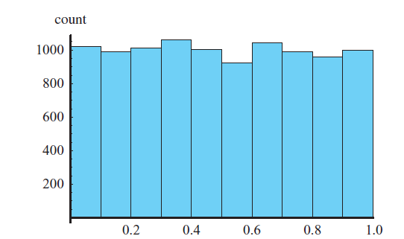
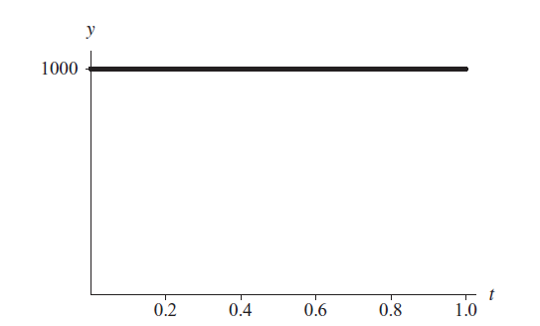
Uniform Distribution
For example, figure on the left presents a histogram with 10 intervals of length 0.1 of a table of 10,000 random floating-point numbers, uniformly distributed from 0.0 up to 1.0.
As expected, approximately one-tenth of the 10,000, or 1000, numbers appears in each subdivision. Thus, the curve across the tops of the bars is virtually a horizontal line of height 1000.
Fig. 3: Histogram of 10,000 random floating-point numbers, uniformly distributed from 0.0 up to 1.0
Fig. 4: Horizontal line at height 1000 approximately goes across the top of the histogram

Slide 30
Discrete and Continuous Distribution
A distribution can be discrete or continuous.
A discrete distribution is a distribution with discrete values. A continuous distribution is a distribution with continuous values.
Discrete data can only take certain values.
Continuous data can take any value (within a range).
To illustrate the difference between the terms discrete and continuous, a digital clock shows time in a discrete manner, from one minute to the next, while a clock with two hands indicates time in a continuous, unbroken

Slide 31
Probability Density Function
For a discrete distribution, a probability function (or density function, or probability density function) returns the probability of occurrence of a particular argument value.
For example, P(1382) might be the probability that the random number generator returns 1382.
However, if a distribution is continuous, the probability of occurrence of any particular value is zero. Thus, for a continuous distribution, a probability function (or density function, or probability density function) indicates the probability that a given outcome falls inside a specific range of

Slide 32
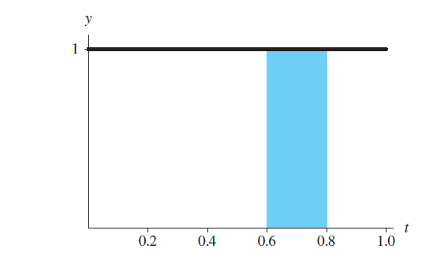
Probability Density Function
The integral of the probability function from the lower to the upper bound of the range, which is the area under that portion of the curve, gives the probability that the outcome is in that range.
For example, the probability that the random velocity in the x-direction of a dust particle is between 3.0 and 4.0 mm/s is the integral of the probability density function from 3.0 to 4.0.
Figure presents a horizontal line of height 1 that is the graph of the probability density function (P(x) = 1) for uniformly generated random numbers with values from 0.0 up to 1.0.
The probability that a uniform random floating-point number between 0.0 and 1.0 falls between 0.6 and 0.8 is the integral of the function f(x) = 1 from 0.6 to 0.8. Thus, the probability is the area of the shaded region between 0.6 and 0.8, which is (0.8 – 0.6) (1.0) = 0.2. Such a random number is between 0.6 and 0.8 for 0.2 = 20% of the time.
Fig. 5: Probability density function for the distribution with histogram in Fig. 3

